Slide 1
ML2 2.4
Evaluating Hyperparameters
Random Forest
Deep Learning (RNN)
By: Jordan Novelli

Slide 2
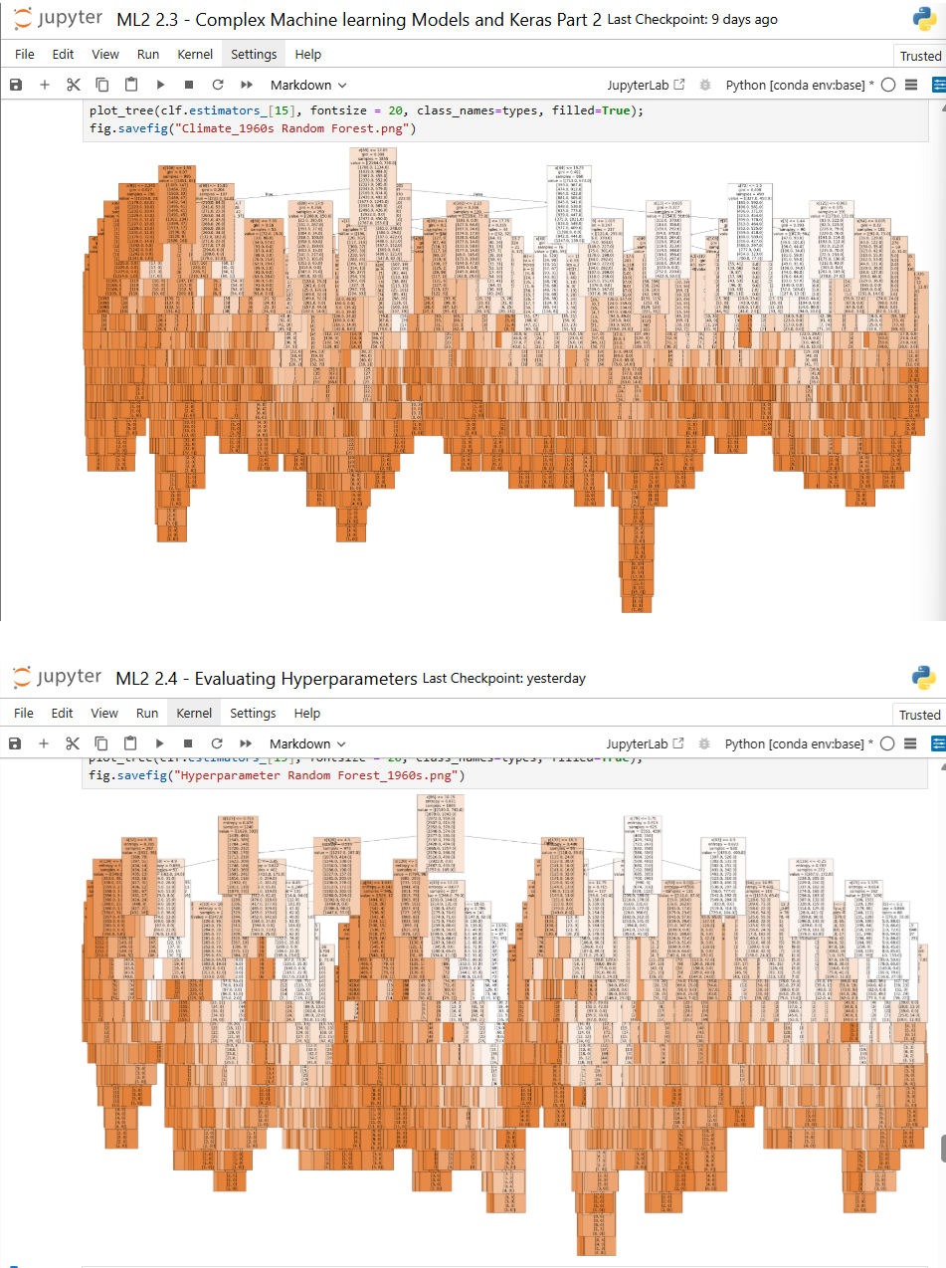
Random Forest with Hyperparameters
There’s not a huge difference in the actual Random Forest images containing the 1960’s decade.
The main difference comes from the accuracy.

Slide 3
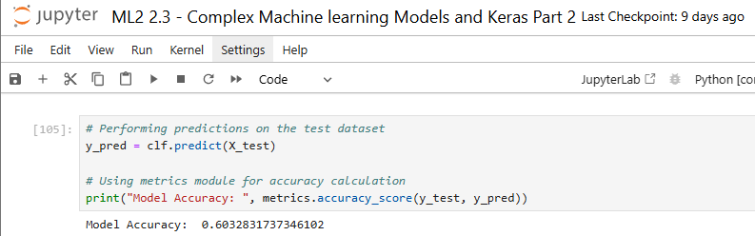
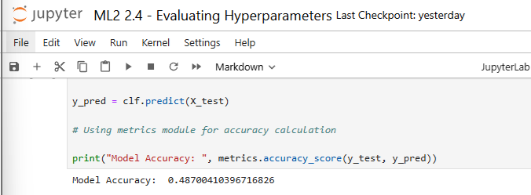
Random Forest with Hyperparameters
Accuracy for the Random Forest was 0.603
Accuracy for the optimized Random Forest was 0.487.
That’s 0.116 lower than the original.
Furthermore, the important features for the RF of 1960s continues to be temp_max and temp_mean.

Slide 4
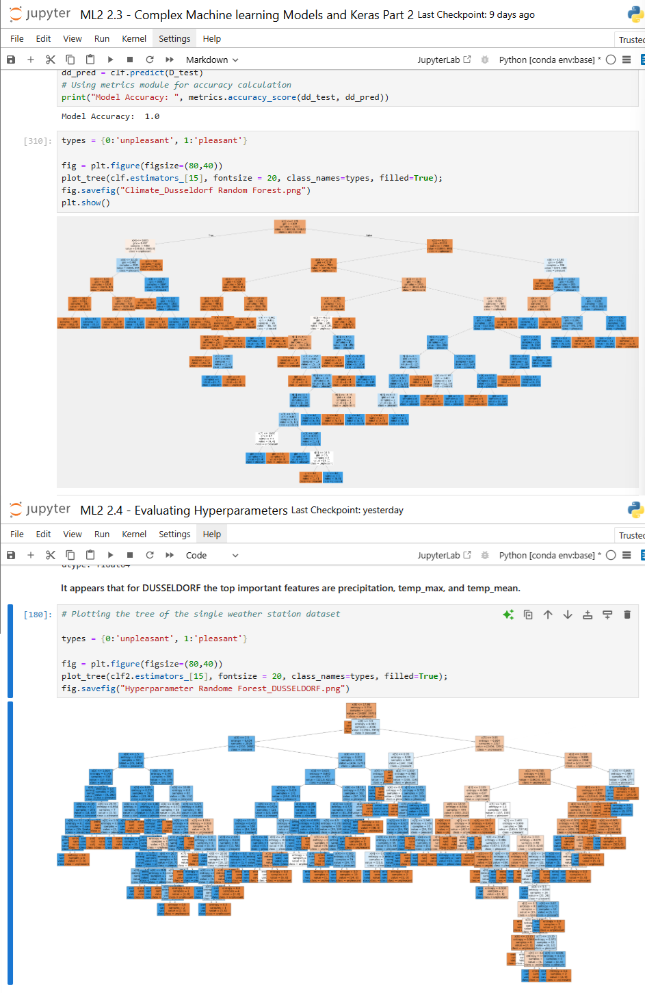
Random Forest with Hyperparameters: DUSSELDORF
The Random Forest image of the original vs the optimized is largely different.
The original RF is much more sparse than the optimized RF.
Accuracy for both the original and optimized RF for DUSSELDORF were 1.0. I believe this is due to the fact that we only looking at the weather station specifically for DUSSELDORF over all the years documented.
The feature importance for the DUSSELDORF Rfcontinue to be precipitation, temp_max and temp_mean.

Slide 5
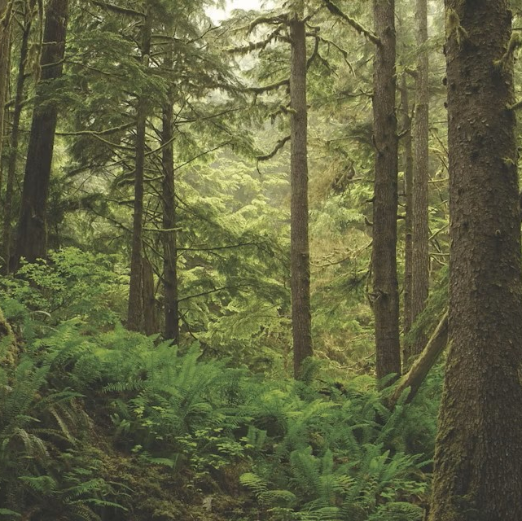
Random Forest Analysis Importance
There isn’t much significance when analyzing the original RF and the optimized RF. The original RF created more accuracy when compared to the optimized RF.
The variables used to determine the RF were no different.

Slide 6
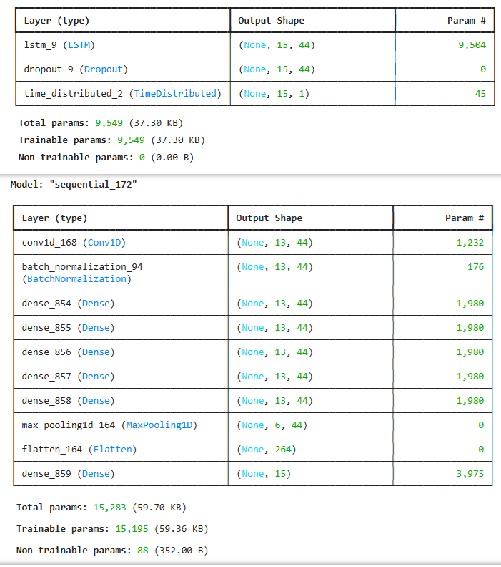
Deep Learning with Hyperparameters
There is a large difference in the Sequential Model.
The model on top is the third RNN run in task 2.2.
The model on bottom is the RNN that was run after using the Bayesian Search in task 2.4.
In task 2.2 the 3rd RNN sequential model was yielding 10:
Total params: 9,549 (37.30 KB)
Trainable params: 9,549 (37.30 KB)
Non-trainable params: 0 (0.00 B)
In this current task 2.4 our sequential model was yielding 172:
Total params: 15,283 (59.70 KB)
Trainable params: 15,195 (59.36 KB)
Non-trainable params: 88 (352.00 B)

Slide 7
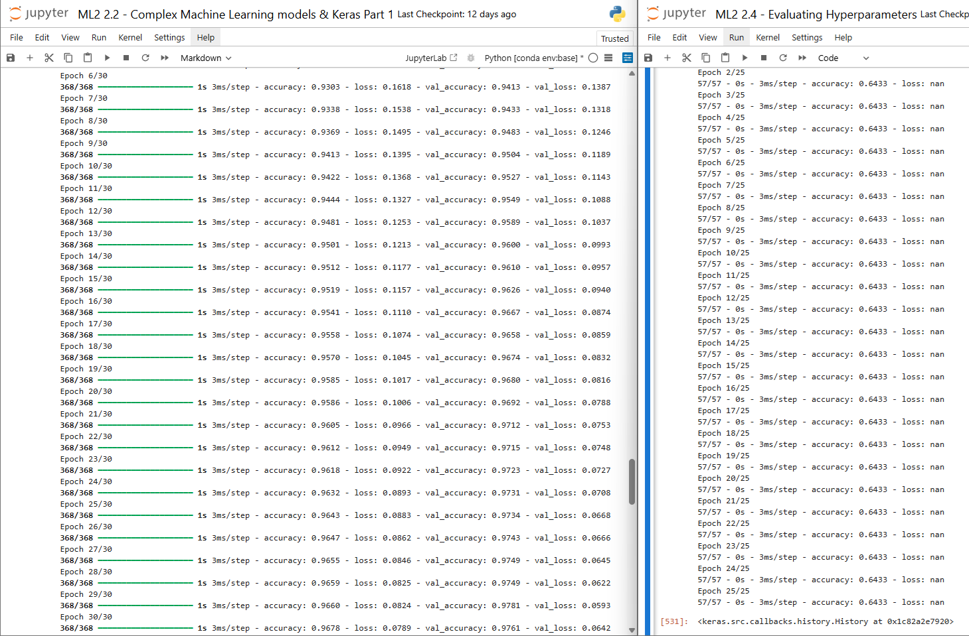
Deep Learning with Hyperparameters
The model.fit of the 3rd RNN of task 2.2 had an epoch of 30 and an accuracy that started at 0.82 and increased to 0.96.
In task 2.4 the model.fit had an epoch of 25 and the accuracy started at 0.63 and only increase to 0.64. That wasn't a very good improvement using the Bayesian Search.
There were some issues with the bayesian search indicating NaN were present when non were showing. This indicates that the algorithms isn't running properly but there are no NaN to be found.

Slide 8
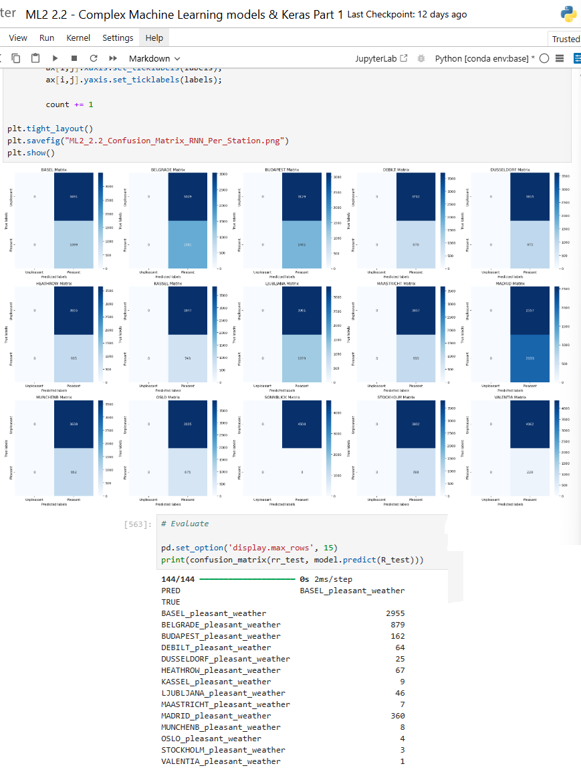
Deep Learning with Hyperparameters
Task 2.4 didn’t require an image of a confusion matrix.
However, a print of the new confusion matrix was created.
The CM displays that Madrid, Basel, Belgrade have some increases pleasant weather days.
Where in the 2.3 task showed that Madrid and Belgrade were #1 and #2. Basel was #5 in the pleasant weather ranking.

Slide 9
Iteration
When conducting iterations, I would maybe lean more towards Random Forest and attempt running both the random and grid search.
I would further break that data down into multiple different decades and look at how the weather has been changing.
Air Ambulance doesn’t have the ability to look at wind speeds so for their most important observations I’d consider sunshine, precipitation and potentially cloud cover.
Each of these evaluations could point to a day that is less likely to be raining making it more difficult and riskier to fly.

Slide 10
END

